Slide 1
Final Project
Truptesh Patel

Slide 2
Problem Statement & Hypothesis
Given the companies financials for the last few years predict the assets of the company for 2016

Slide 3
Dataset Description
Data Dictionary:
company_id, name_latest , names_previous , indicator_id ,2010,2011,2012,2013,2014,2015,2016
How it was obtained: this is a kaggle dataset. This dataset contains US stocks fundamental data, such as income statement, balance sheet and cash flows. This is a public dataset available on kaggle

Slide 4
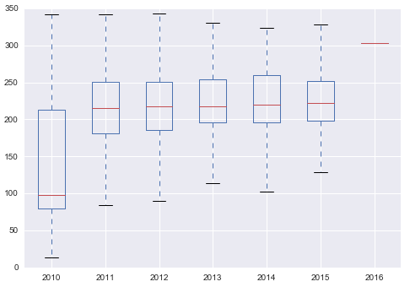
Preprocessing Steps
Data Cleaning: the data had a lot of null values and values were present in some years and missing in some other years.

Slide 5
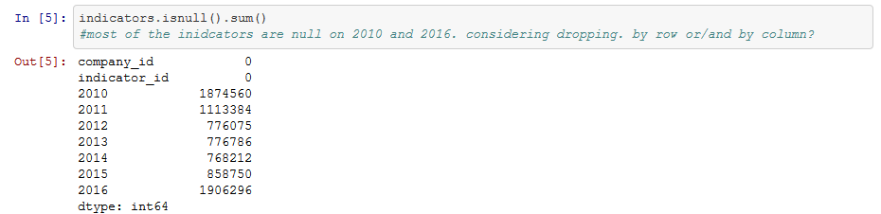
Preprocessing Steps
Data Cleaning: the data had a lot of null values and values were present in some years and missing in some other years.

Slide 6
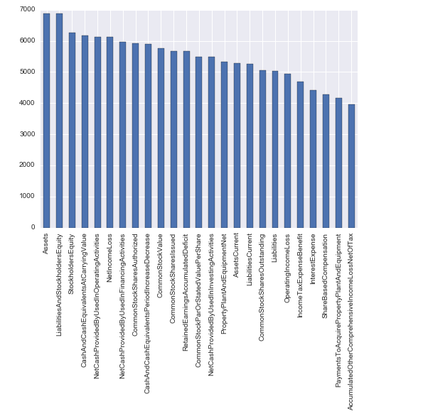
Exploratory Data Analysis Insights
To understand the data I created charts for each year to get the top 25 indicators for each year. (2011 indicatotrs)

Slide 7
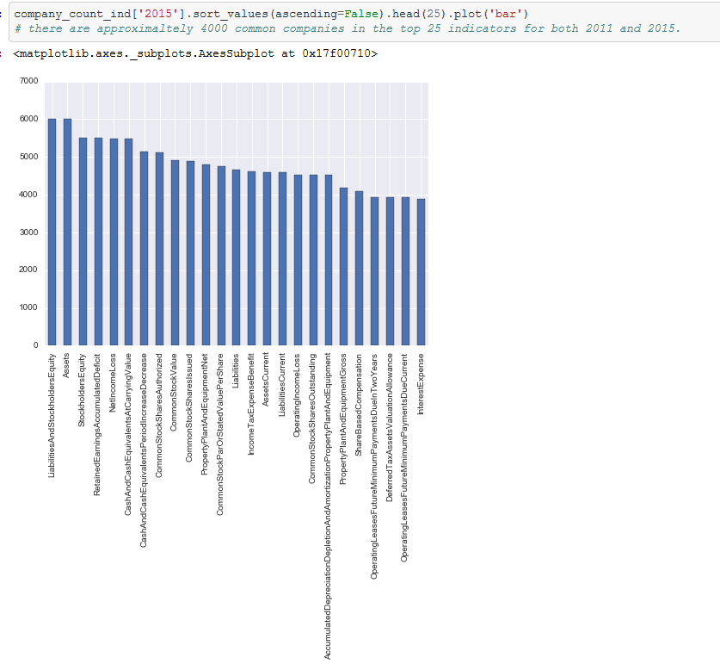

Slide 8
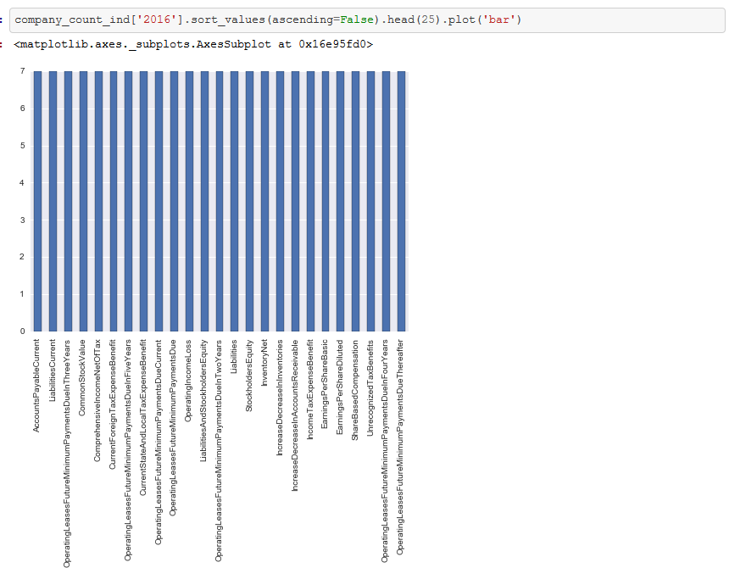

Slide 9
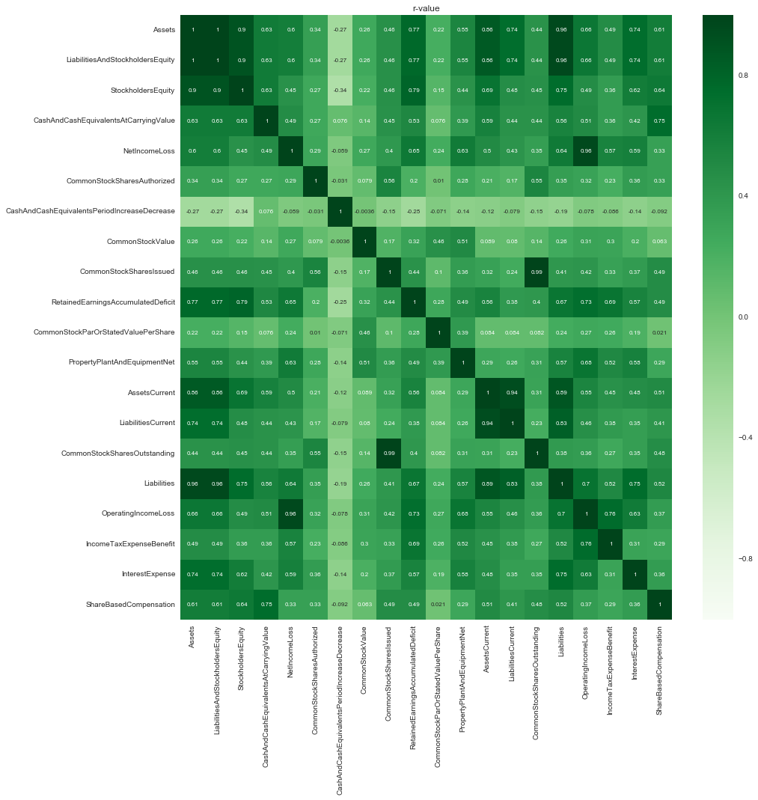

Slide 10
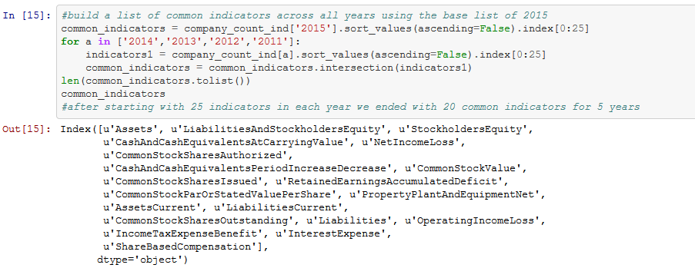

Slide 11
Feature Engineering

Slide 12
Model Selection & Evaluation Metrics

Slide 13
Success & Challenges
Challenges:
Knowing the libraries and visualizing the data structures to pass to each function.
The data does not have enough indicators to predict fraud but can be used to predict valuation of the company based common indicators available when time series analysis is performed on it
Success:

Slide 14
Next Steps
Based on the indicators that will not leak in the target “Assets” do a time series analysis to predict the valuation of the company

Slide 15
Conclusion & Key Learnings
Include time for QA

